Slide 1
Farm university
by: cedar chest

Slide 2

The idea

Slide 3
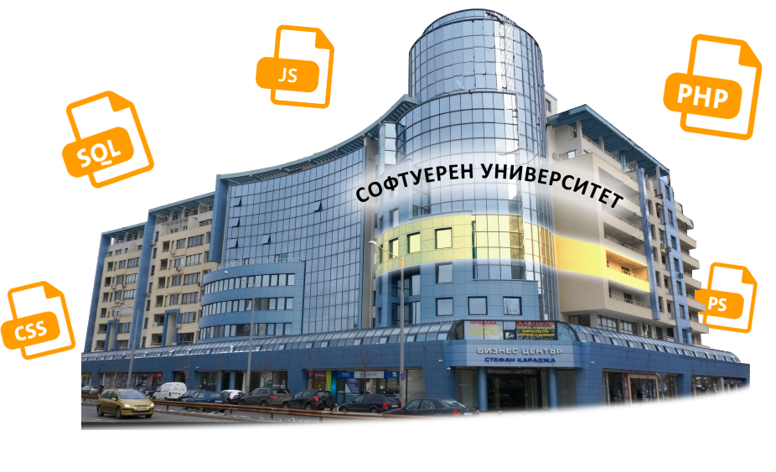
Software university

Slide 4

People in university

Slide 5

opposite

Slide 6
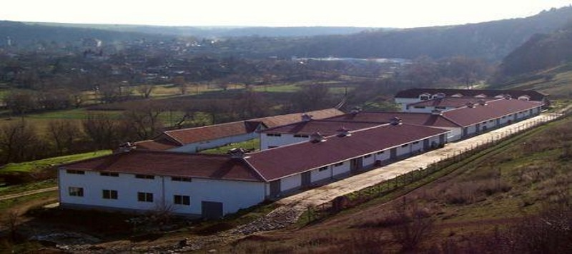
Farm university

Slide 7
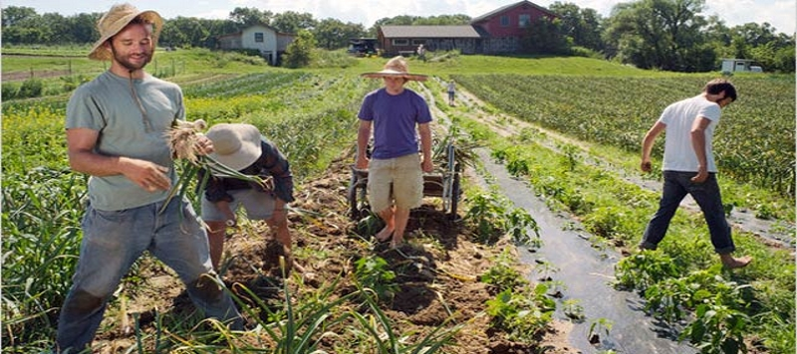
People in university

Slide 8
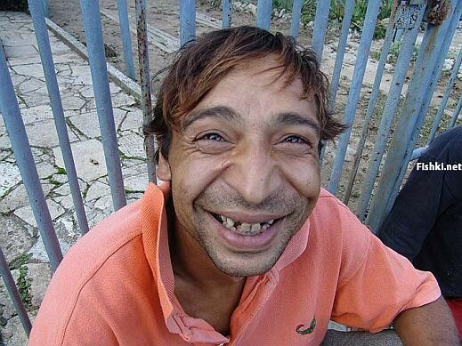
Cooooool :D
http://farmuni.host56.com/

